Slide 2
Why decentralized mixing?
No bootstrapping problem
Theft impossible
Possibly better anonymity
More philosophically aligned with Bitcoin

Slide 3



Coinjoin
Each signature is entirely separate
This is 1 mixing round
Mixing principles from before apply on top of basic protocol
Single
transaction
Proposed by Greg Maxwell, Bitcoin core developer

Slide 4
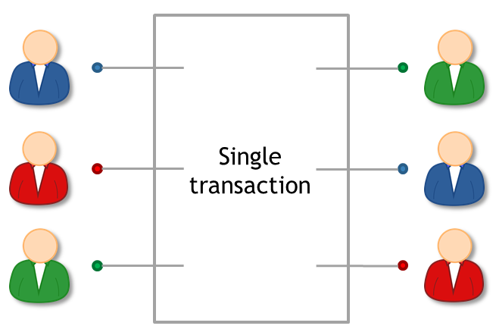
Coinjoin algorithm
Find peers who want to mix
Exchange input/output addresses
Construct transaction
Send it around, collect signatures (Before signing, each peer checks if her output is present)
Broadcast the transaction

Slide 5
Coinjoin: remaining problems
How to find peers
Peers know your input-output mapping (This is a worse problem than for centralized mixes)
Denial of service

Slide 6
Finding peers
Use an untrusted server

Slide 7
Peer anonymity
Strawman solution:
exchange inputs
disconnect and reconnect over Tor
exchange outputs
Better solution: special-purpose anonymous routing mechanism
Notes:
Note: not necessary to communicate outputs securely

Slide 8
Denial of service
Proposed solutions:
Proof of work
Proof of burn
Server kicks out malicious participant
Cryptographic “blame” protocol (CoinShuffle: Practical Decentralized Coin Mixing for Bitcoin T. Ruffing et al., PETS 2014)

Slide 9
High-level flows could be identifying
Example:
Alice receives 43.12312 BTC / week as income Always immediately transfers 5% to retirement account

Slide 10
Heuristic: merge avoidance
Instead of a single payment transaction
receiver provides multiple output addresses
sender avoids combining different inputs
(Proposed by Mike Hearn)
Notes:
Can go a long way to improve anonymity even without mixes

Slide 11
Zerocoin and Zerocash

Slide 12
Zerocoin: protocol-level mixing
Mixing capability baked into protocol
Advantage: cryptographic guarantee of mixing
Disadvantage: not currently compatible with Bitcoin
Zerocoin: Anonymous Distributed E-Cash from Bitcoin
I. Miers et al.
IEEE S&P 2013

Slide 13
Basecoin and Zerocoin
Basecoin: Bitcoin-like Altcoin
Zerocoin: Extension of Basecoin
Basecoins can be converted into zerocoins and back
Breaks link between original and new basecoin

Slide 14
Minting zerocoins
Zerocoins come in standard denominations
(Let’s assume 1 basecoin)
Anyone can make one!
They have value once put on the block chain
That costs 1 basecoin

Slide 15

Minting a zerocoin: “commitment”
Generate serial number S
(eventually made public)
and random secret r
(never public, ensures
unlinkability)
Compute H(S, r)
Serial number:
317038628684424
Simplification

Slide 16
Minting a zerocoin
To put H(S, r) on block chain
Create Mint Tx with 1 basecoin as input
signed by A
Mint
H(S, r) H( )

Slide 17
To spend a zerocoin S:
Reveal S (miners will verify S hasn’t been spent before)
Create zero-knowledge proof that: “I know a number r such that H(S, r) is one of the zerocoins in the block chain”
The system only sees that some valid coin is being spent, not which one.

Slide 18

Zerocoin is anonymous
Since r is secret, no one can figure out which zerocoin corresponds to serial number S
H(S, r)
…
h₁
h₂
h_{N}

Slide 19
Key Features:
Anonymity: Breaks the link between payer and payee.
Uses zero-knowledge proofs (ZKP): Proves you own a valid coin without revealing it.
Published balances: Amounts are still visible.
Zerocoin Security Properties:
Unlinkability: No way to match the new basecoin to the old
ZKPs ensure uniqueness: Each serial number is used only once
Zerocoin's anonymity is cryptographically guaranteed

Slide 20
Limitations of Zerocoin:
Large proof size (~50 KB per transaction).
Requires trusted setup (cryptographic parameters that must be safely generated and destroyed).
Not fully private (transaction amounts are still visible).
Deployability

Slide 21
Zero-knowledge proofs
Crypto
magic
A way to prove a statement
without revealing any other
information
Example:
“I know an input that hashes to da39a3ee5e”
“I know an input that hashes to some hash in the following set: … ”

Slide 22
Zero coin and Zero cash
ZeroCoin was initially proposed as a privacy extension to Bitcoin. It aimed to add anonymity to Bitcoin transactions.
The concept of ZeroCoin eventually evolved into Zcoin, which is now known as Firo (a privacy-focused cryptocurrency).
ZeroCash was developed as an evolution of ZeroCoin, offering more efficient and secure privacy.
It formed the basis of the cryptocurrency Zcash, which is a well-known privacy-centric cryptocurrency.
With Zcash, users can choose between transparent and shielded transactions, providing flexibility in how much privacy they want.

Slide 23
Zero-knowledge proofs
introduced by Goldwasser, Micali, and Rackoff in 1985
Three properties of ZKPs that are required:
-- Completeness
-- soundness.
-- zero-knowledge property

Slide 24
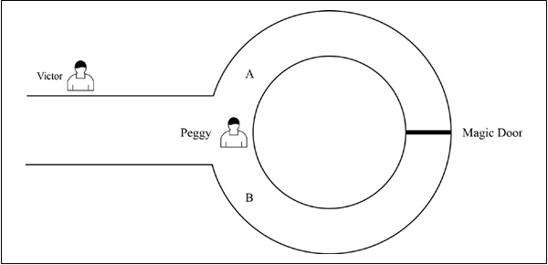
The steps that are taken by both Peggy and Victor to reach a conclusion regarding whether Peggy knows the secret or not:
1.First, Victor waits outside the main cave entrance and Peggy goes in the cave.
2.Peggy randomly chooses either the A or B entrance to the cave.
3.Now, Victor enters the cave and shouts either A or B randomly, asking Peggy to come out of the exit he named.
4.Victor records which exit Peggy comes out from.
Analogy of the zero-knowledge mechanism

Slide 25
Peggy and Victor repeatedly performing this routine proves knowledge of the secret with high probability.as probability of guessing or getting lucky reduces to the point of being negligible after n number of rounds.

Slide 26
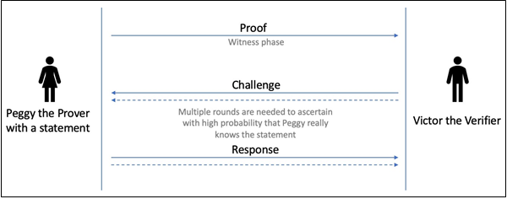
A ZKP comprises the following phases:
1.Witness phase: In this phase, the prover sends proof of the statement and sends it to the verifier.
2.Challenge phase: In this phase, the verifier chooses a question (challenge) and sends it to the prover.
3.Response phase: In this phase, the prover generates an answer and sends it as a response to the verifier. The verifier then checks the answer to ascertain whether the prover really knows the statement.
A zero-knowledge proof scheme

Slide 27
Applications of ZKP :
--proof of ownership
that is, proof that the prover is the owner of some secret or a private key without revealing the nature of it
--proof of age
where the prover proves that they are, for example, older than 25 years, but do not want to reveal their exact age
--Another application could be where citizens can pay taxes without revealing their income.
zk-SNARKs
The zk-SNARK is a variant of ZKPs that is more efficient and simpler to use and implement.

Slide 28
Zk-SNARKs Properties:
Zero knowledge (zk): This property allows a prover to convince a verifier that an assertion (statement) is true without revealing any information about it
Succinct (S): This property allows for a small proof that is very quick to verify and is succinct.
Non-interactive (N): This property allows the prover to prove a statement without any interaction with the verifier.
ARguments of Knowledge (ARKs): These are the arguments to convince the verifier that the prover's assertion is true.
Remember that we discussed soundness and completeness earlier. In the case of ARKs, the prover has a computational soundness property, meaning that the prover is computationally bounded, and it is computationally infeasible for it to cheat the verifier.

Slide 29
The biggest criticism of zk-SNARKs is the initial trusted setup
zk-STARKs
Zero-knowledge Scalable Transparent ARguments of Knowledge (zk-STARKs) are a new type of ZKP that has addressed limitations in zk-SNARKs.

Slide 30
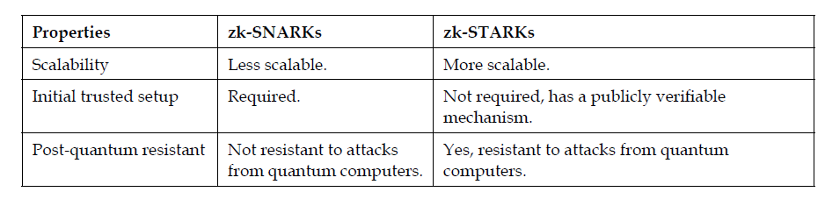
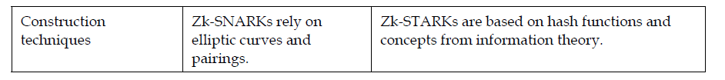
The key differences between the zk-STARK and zk-SNARK :

Slide 31
Zerocoins
A Zerocoin is a cryptographic proof that you owned a Basecoin and made it unspendable
ZeroCoin was initially proposed as a privacy extension to Bitcoin. It aimed to add anonymity to Bitcoin transactions.
The concept of ZeroCoin eventually evolved into Zcoin, which is now known as Firo (a privacy-focused cryptocurrency).
Miners can verify these proofs
Gives you the right to redeem a new Basecoin

Slide 32
Zerocash: Zerocoin without Basecoin
Two differences
Different crypto for proofs (More efficient)
Proposal to run system without Basecoin
Zerocash: Decentralized Anonymous Payments from Bitcoin
E. Ben-Sasson et al.
Usenix Security 2014
Notes:
Sender and recipients know amounts, but nobody else
Prove to miners in zero knowledge that input amount >= output amount
Avoids side-channel problems associated with mixing

Slide 33
Zerocash: untraceable e-cash
All transactions are zerocoins
Splitting and merging supported
Put transaction value inside the envelope
Ledger merely records existence of transactions
Notes:
Sender and recipients know amounts, but nobody else
Prove to miners in zero knowledge that input amount >= output amount
Avoids side-channel problems associated with mixing

Slide 34
Zerocash: the catch
Random, secret inputs are required to generate public parameters
These secret inputs must then be securely destroyed
No one can know them (anyone who does can break the system)
Notes:
Believability

Slide 35
5 levels of anonymity
System | Type | Anonymity attacks | Deployability
Bitcoin | Pseudonymous | Tx graph analysis | Default
Single mix | Mix | Tx graph analysis, bad mix | Usable today
Mix chain | Mix | Side channels, bad mixes/peers | Bitcoin-compatible
Zerocoin | Cryptographic mix | Side channels (possibly) | Altcoin
Zerocash | Untraceable | None | Altcoin, tricky setup
Notes:
Engineering complexity, believability

